Slide 1




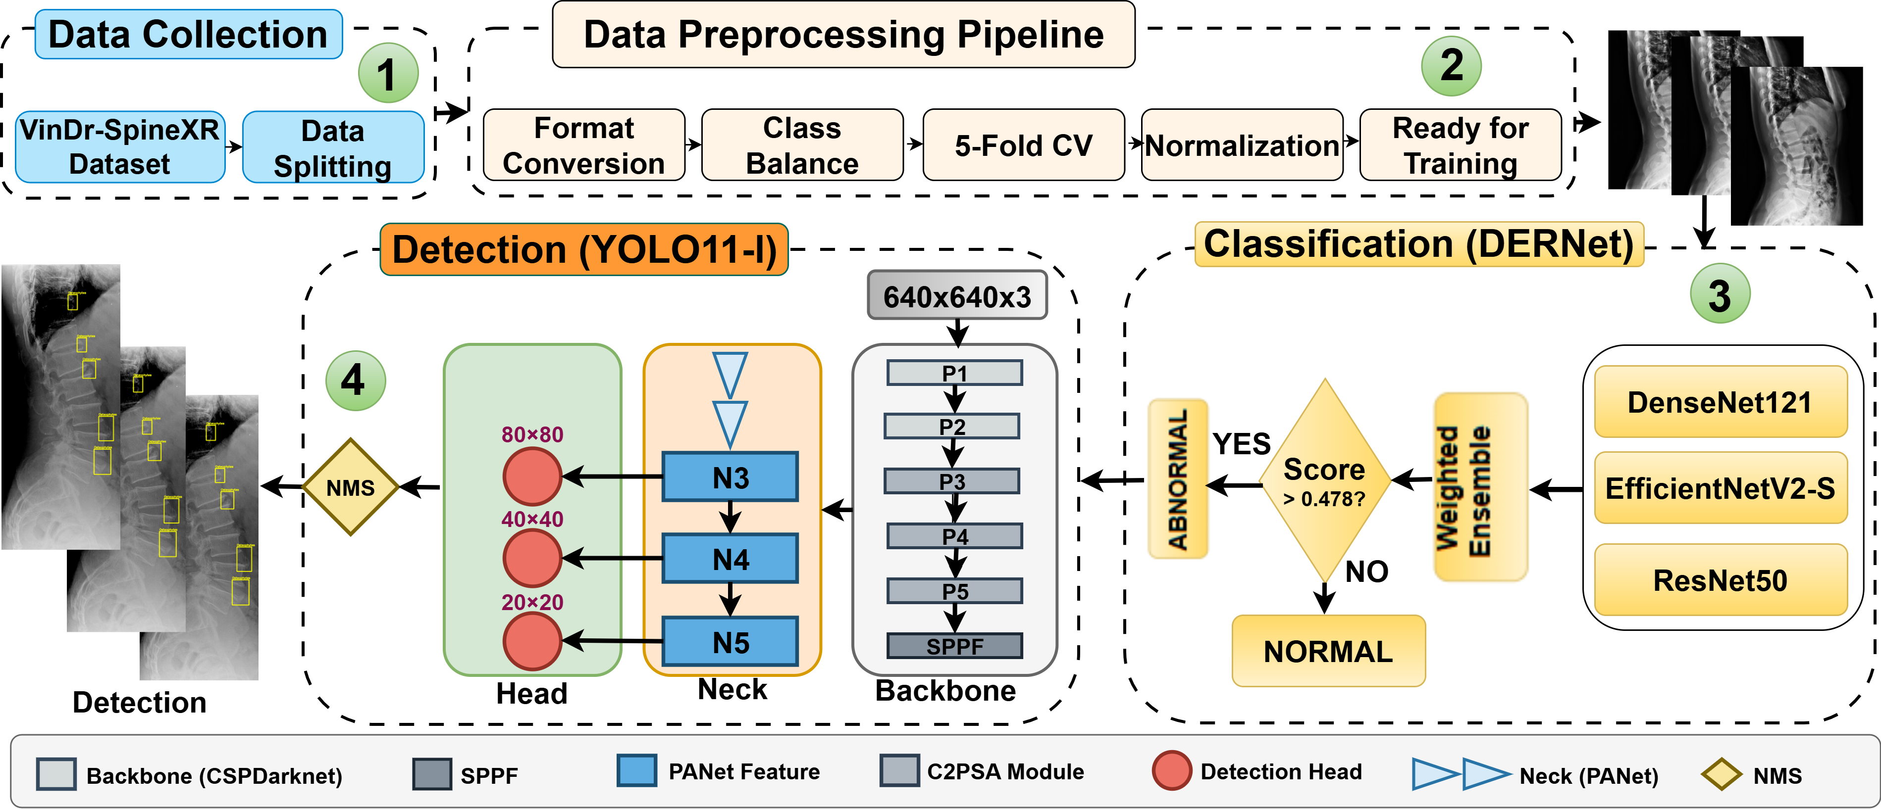
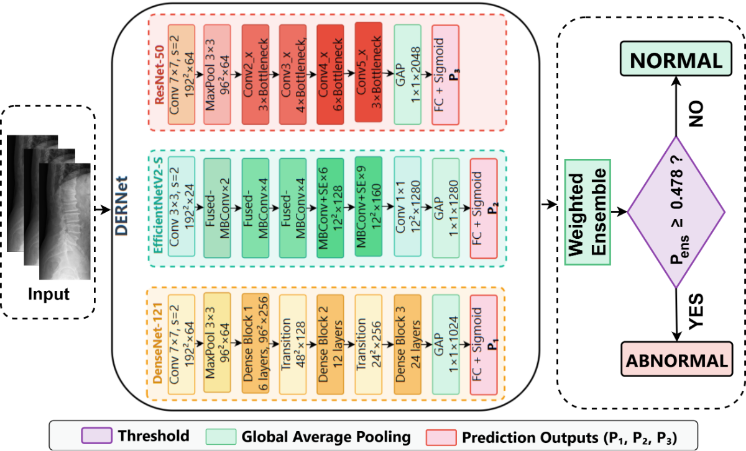
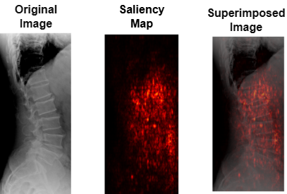
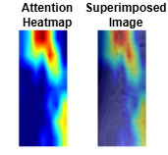
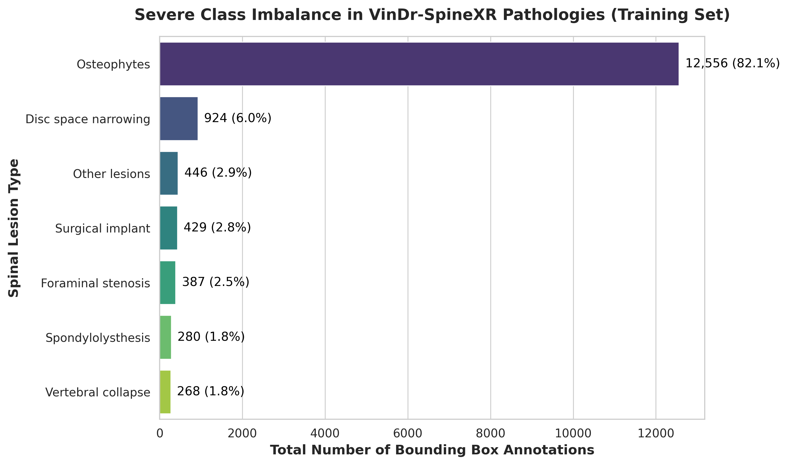



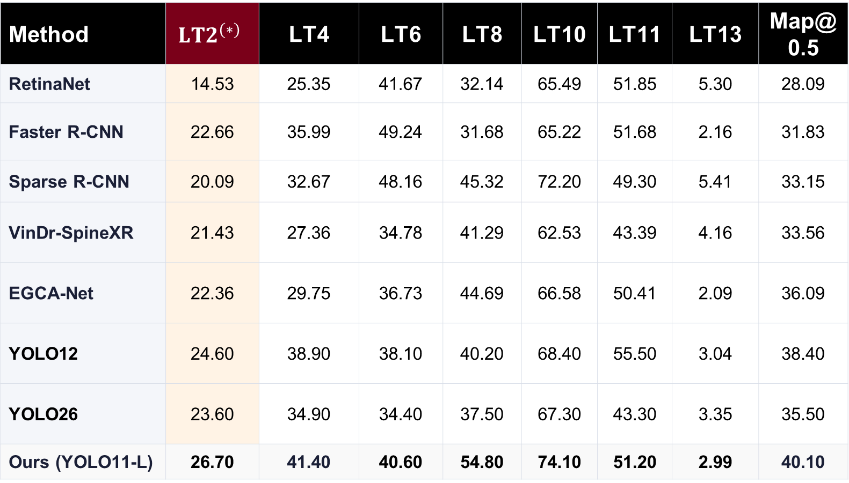


A Sensitivity-Gated Cascade for Compute-Efficient Spinal Lesion Detection in Resource-Constrained Settings
1
Prosenjit Mondol , Samrat Kumar Dey and Arpita Howlader
¹Faculty of Computer Science and Engineering, Patuakhali Science and Technology University, Dumki 8602, Bangladesh.
²School of Science and Technology, Bangladesh Open University, Gazipur 1705, Bangladesh
2
1
Motivation
  Cascaded Framework
  Results
Spinal radiographs serve as the primary screening modality for a wide spectrum of spinal pathologies [1evaluating]. This visual ambiguity induces high inter-observer variability and elevates the risk of delayed diagnoses, which can precipitate irreversible neurological sequelae.
Table 1. Classification performance comparison
Method | AUROC | F1 (%) | Sens. (%) | Spec. (%)
EfficientNetV2-S | 89.44 | 79.34 | 70.80 | 91.12
ResNet50 | 88.88 | 80.15 | 82.72 | 78.13
DenseNet121 | 86.93 | 79.55 | 80.39 | 79..32
VinDr Ensemble | 88.61 | 81.06 | 83.07 | 79.32
HealNNet | 88.84 | 81.20 | - | -
DERNet | 91.03 | 83.09 | 84.91 | 81.68
46.9 : 1
class imbalance ratio between majority (82.1%) and critical minority lesions [2]
Table 2. Comparison results of different methods.
The detection performance for each type of spinal
lesion is evaluated by AP (%) at 0.5 IoU threshold.
<1%
of the radiograph field-of-view occupied by minute, subtle pathologies [2]
Method | $${LT2}^{(∗)}$$ | LT4 | LT6 | LT8 | LT10 | LT11 | LT13 | Map@0.5
RetinaNet | 14.53 | 25.35 | 41.67 | 32.14 | 65.49 | 51.85 | 5.30 | 28.09
Faster R-CNN | 22.66 | 35.99 | 49.24 | 31.68 | 65.22 | 51.68 | 2.16 | 31.83
Sparse R-CNN | 20.09 | 32.67 | 48.16 | 45.32 | 72.20 | 49.30 | 5.41 | 33.15
VinDr-SpineXR | 21.43 | 27.36 | 34.78 | 41.29 | 62.53 | 43.39 | 4.16 | 33.56
EGCA-Net | 22.36 | 29.75 | 36.73 | 44.69 | 66.58 | 50.41 | 2.09 | 36.09
YOLO12 | 24.60 | 38.90 | 38.10 | 40.20 | 68.40 | 55.50 | 3.04 | 38.40
YOLO26 | 23.60 | 34.90 | 34.40 | 37.50 | 67.30 | 43.30 | 3.35 | 35.50
Ours (YOLO11-L) | 26.70 | 41.40 | 40.60 | 54.80 | 74.10 | 51.20 | 2.99 | 40.10
  Gaps in Current Approaches
Fig. 2. Overview of the cascaded framework for spinal
lesion triage and localization.
1
Sensitivity-Specificity Trade-Off
Monolithic models trigger high false positives or miss critical subtle lesions under data skew [3]
  Methods
2
Extreme Class Imbalance
Two-Stage Hierarchical Decoupling
Minute pathologies (<1% FOV) are easily obscured by bone superposition and dominant classes [4-5]
S₁
DERNet Triage
I
S₂
Detector
(*) LT2, LT4, LT6, LT8, LT10, LT11, and LT13 denote disc space
narrowing, foraminal stenosis, osteophytes, spondylolisthesis,
surgical implant, vertebral collapse, and other lesions, respectively.
3
High Computational Overhead
  DERNet Framework
Running heavy detectors on normal screening X-rays prevents CPU deployment in low-resource clinics[1,6]
  AI Explainability (XAI)
  Contributions
Sensitivity-Gated Cascade DERNet Framework
Heterogeneous ensemble of DenseNet121, EfficientNetV2-S, and ResNet50 with weighted soft voting, achieving 91.03% AUROC to filter normal studies
Attention-Guided Localization
Fig. 4. Explainability for the lesion localization
Customized YOLO11-L with CSP-Darknet and C2PSA attention to overcome severe 46.9:1 class imbalance and localize minute lesions, achieving 40.10% mAP@0.5.
  Efficiency & Ablation
CPU Triage
15.4 GFLOPS screening filters normals upfront; heavier 74.6 GFLOPS detector executes on abnormalities for CPU triage.
Transparent & Compute-Efficient Inference
Imbalance Ablation
20% copy-paste lifts mAP@0.5 from 37.70% → 40.10% on rare lesions.
Integrates multi-modal explainability Saliency Maps, Grad-CAM, and LIME quantitatively grounded to authentic lesions, coupled with a staged pipeline optimized for practical CPU deployment in resource-constrained
Fig. 3. DERNet probabilistic ensemble architecture for sensitivity radiographic triage. Each backbone (DenseNet121, EfficientNetV2-S, ResNet50) produces independent posterior probabilities via Global Average Pooling and Sigmoid.
Anatomical Trust
0.61–0.64 mean X-IoU grounds triage to bone margins, safeguarding scarce MRI slots.
  Data Descriptions
  Conclusion
Composite Objective & Focal Formulation
Decouples screening triage from localization via a sensitivity-gated DERNet and YOLO11-L cascade. Delivers 91.03% AUROC and 40.10% mAP@0.5, quantitatively grounded to authentic bone pathology (0.64 X-IoU). Enables CPU-efficient triage (120 ms) in resource-constrained clinics, strictly reserving scarce MRI slots.
${FL}_{\left(p_{t}\right)}=−α_{t}{\left(1 − p_{t}\right)}^{γ}log(p_{t})$
$$𝓛_{total}= λ_{box}𝓛_{CIoU}+ λ_{cls}𝓛_{Focal}+ λ_{dfl}𝓛_{DFL}$$
Suppresses easy negative background gradients to anchor optimization on rare foreground lesions.
Fig. 1. Severe 46.9:1 class imbalance across seven spinal lesion categories in the VinDr-SpineXR training cohort
1
Probabilistic Soft Voting
Scan this QR for additional resources including code, data
DATASET & COHORT SUMMARY
$$P_{ens}≥0.478$$
filters normal studies; abnormal go to YOLO11-L
2
C2PSA Bone Feature Attention
Source: VinDr-SpineXR v1.0.0 (PhysioNet)
Cohort: 10,466 spinal radiographs ( 8,389 train | 2,077 test )
Expert Labels: Radiologist-annotated bounding boxes across 7 lesion categories
46.9:1 Imbalance: Osteophytes (82.1%, n = 12,556) vs. Collapse (1.8%, n = 268)
Minute Scale: Subtle lesions occupy <1% FOV (<32×32 px)
Preserves boundary gradients along subtle vertebral edges
REFERENCES
3
Multi-Scale Detection Heads
[1] A deep learning framework for spinal lesions detection and classification from radiographs. pages 291–301. Springer, 2021.
[2] VinDr-SpineXR: A large annotated medical image dataset for spinal lesions detection and classification from radiographs. PhysioNet, August 2021. Version 1.0.0.
[3] Sparse r-cnn: End-to-end object detection with learnable proposals. In Proceedings of the IEEE/CVFconference, 2021.
[4] Federated vision transformer with adaptive focal loss for medical image classifica-tion. Knowledge-Based Systems, 2026.
[5] Elizabeth A Krupinski, Kevin S Berbaum, RT Caldwell, KM Schartz, and J Kim. Long radiology workdays reduce detection and accommodation accuracy.
[6] Healnnet-lesions: A deep learning framework for spinal lesiondetection demonstrating x-ray images as a screening alternative to mri and ct withdeep learning in radiology. 2025
Hierarchical PANet feature fusion isolates minute pathologies occupying <1% FOV
4
Targeted Copy-Paste Augmentation
Overcomes severe 46.9:1 class skew to stabilize regression for rare categories

Slide 2
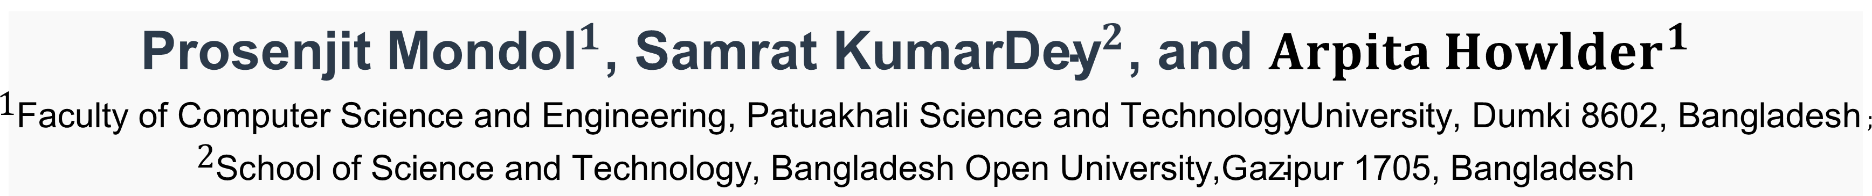

(P) A Sensitivity-Gated Cascade for Compute-Efficient Spinal Lesion Detection in Resource-Constrained Settings
${\text{Prosenjit} \text{Mondol}}^{1}$, ${\text{Samrat} \text{KumarDey}}^{2}$, and ${Arpita Howlder}^{1}$
$1_{\text{Faculty} \text{of} \text{Computer} \text{Science} \text{and} \text{Engineering}\text{, }\text{Patuakhali} \text{Science} \text{and} \text{TechnologyUniversity}\text{, }\text{Dumki}\text{ 8602, }\text{Bangladesh} ;}$ $2_{\text{School} \text{of} \text{Science} \text{and} \text{Technology}\text{, }\text{Bangladesh} \text{Open} \text{University}\text{,}\text{Gazipur}\text{ 1705, }\text{Bangladesh}}$
Motivation
  Cascaded Framework
  Results
Spinal radiographs serve as the primary screening modality for a wide spectrum of spinal pathologies [1evaluating]. This visual ambiguity induces high inter-observer variability and elevates the risk of delayed diagnoses, which can precipitate irreversible neurological sequelae.
Table 1. Classification performance comparison
Method | AUROC | F1 (%) | Sens. (%) | Spec. (%)
EfficientNetV2-S | 89.44 | 79.34 | 70.80 | 91.12
ResNet50 | 88.88 | 80.15 | 82.72 | 78.13
DenseNet121 | 86.93 | 79.55 | 80.39 | 79..32
VinDr Ensemble | 88.61 | 81.06 | 83.07 | 79.32
HealNNet | 88.84 | 81.20 | - | -
DERNet | 91.03 | 83.09 | 84.91 | 81.68
46.9 : 1
class imbalance ratio between majority (82.1%) and critical minority lesions [2]
Table 2. Comparison results of different methods.
The detection performance for each type of spinal
lesion is evaluated by AP (%) at 0.5 IoU threshold.
<1%
of the radiograph field-of-view occupied by minute, subtle pathologies [2]
Method | $${LT2}^{(∗)}$$ | LT4 | LT6 | LT8 | LT10 | LT11 | LT13 | Map@0.5
RetinaNet | 14.53 | 25.35 | 41.67 | 32.14 | 65.49 | 51.85 | 5.30 | 28.09
Faster R-CNN | 22.66 | 35.99 | 49.24 | 31.68 | 65.22 | 51.68 | 2.16 | 31.83
Sparse R-CNN | 20.09 | 32.67 | 48.16 | 45.32 | 72.20 | 49.30 | 5.41 | 33.15
VinDr-SpineXR | 21.43 | 27.36 | 34.78 | 41.29 | 62.53 | 43.39 | 4.16 | 33.56
EGCA-Net | 22.36 | 29.75 | 36.73 | 44.69 | 66.58 | 50.41 | 2.09 | 36.09
YOLO12 | 24.60 | 38.90 | 38.10 | 40.20 | 68.40 | 55.50 | 3.04 | 38.40
YOLO26 | 23.60 | 34.90 | 34.40 | 37.50 | 67.30 | 43.30 | 3.35 | 35.50
Ours (YOLO11-L) | 26.70 | 41.40 | 40.60 | 54.80 | 74.10 | 51.20 | 2.99 | 40.10
  Gaps in Current Approaches
Fig. 2. Overview of the cascaded framework for spinal
lesion triage and localization.
1
Sensitivity-Specificity Trade-Off
Monolithic models trigger high false positives or miss critical subtle lesions under data skew [3]
  Methods
2
Extreme Class Imbalance
Two-Stage Hierarchical Decoupling
Minute pathologies (<1% FOV) are easily obscured by bone superposition and dominant classes [4-5]
S₁
DERNet Triage
I
S₂
Detector
(*) LT2, LT4, LT6, LT8, LT10, LT11, and LT13 denote disc space
narrowing, foraminal stenosis, osteophytes, spondylolisthesis,
surgical implant, vertebral collapse, and other lesions, respectively.
3
High Computational Overhead
  DERNet Framework
Running heavy detectors on normal screening X-rays prevents CPU deployment in low-resource clinics[1,6]
  AI Explainability (XAI)
  Contributions
Sensitivity-Gated Cascade DERNet Framework
Heterogeneous ensemble of DenseNet121, EfficientNetV2-S, and ResNet50 with weighted soft voting, achieving 91.03% AUROC to filter normal studies
Attention-Guided Localization
Fig. 4. Explainability for the lesion localization
Customized YOLO11-L with CSP-Darknet and C2PSA attention to overcome severe 46.9:1 class imbalance and localize minute lesions, achieving 40.10% mAP@0.5.
  Efficiency & Ablation
CPU Triage
15.4 GFLOPS screening filters normals upfront; heavier 74.6 GFLOPS detector executes on abnormalities for CPU triage.
Transparent & Compute-Efficient Inference
Imbalance Ablation
20% copy-paste lifts mAP@0.5 from 37.70% → 40.10% on rare lesions.
Integrates multi-modal explainability Saliency Maps, Grad-CAM, and LIME quantitatively grounded to authentic lesions, coupled with a staged pipeline optimized for practical CPU deployment in resource-constrained
Fig. 3. DERNet probabilistic ensemble architecture for sensitivity radiographic triage. Each backbone (DenseNet121, EfficientNetV2-S, ResNet50) produces independent posterior probabilities via Global Average Pooling and Sigmoid.
Anatomical Trust
0.61–0.64 mean X-IoU grounds triage to bone margins, safeguarding scarce MRI slots.
  Data Descriptions
  Conclusion
Composite Objective & Focal Formulation
Decouples screening triage from localization via a sensitivity-gated DERNet and YOLO11-L cascade. Delivers 91.03% AUROC and 40.10% mAP@0.5, quantitatively grounded to authentic bone pathology (0.64 X-IoU). Enables CPU-efficient triage (120 ms) in resource-constrained clinics, strictly reserving scarce MRI slots.
${FL}_{\left(p_{t}\right)}=−α_{t}{\left(1 − p_{t}\right)}^{γ}log(p_{t})$
$$𝓛_{total}= λ_{box}𝓛_{CIoU}+ λ_{cls}𝓛_{Focal}+ λ_{dfl}𝓛_{DFL}$$
Suppresses easy negative background gradients to anchor optimization on rare foreground lesions.
Fig. 1. Severe 46.9:1 class imbalance across seven spinal lesion categories in the VinDr-SpineXR training cohort
1
Probabilistic Soft Voting
Scan this QR for additional resources including code, data
DATASET & COHORT SUMMARY
$$P_{ens}≥0.478$$
filters normal studies; abnormal go to YOLO11-L
2
C2PSA Bone Feature Attention
Source: VinDr-SpineXR v1.0.0 (PhysioNet)
Cohort: 10,466 spinal radiographs ( 8,389 train | 2,077 test )
Expert Labels: Radiologist-annotated bounding boxes across 7 lesion categories
46.9:1 Imbalance: Osteophytes (82.1%, n = 12,556) vs. Collapse (1.8%, n = 268)
Minute Scale: Subtle lesions occupy <1% FOV (<32×32 px)
Preserves boundary gradients along subtle vertebral edges
REFERENCES
3
Multi-Scale Detection Heads
[1] A deep learning framework for spinal lesions detection and classification from radiographs. pages 291–301. Springer, 2021.
[2] VinDr-SpineXR: A large annotated medical image dataset for spinal lesions detection and classification from radiographs. PhysioNet, August 2021. Version 1.0.0.
[3] Sparse r-cnn: End-to-end object detection with learnable proposals. In Proceedings of the IEEE/CVFconference, 2021.
[4] Federated vision transformer with adaptive focal loss for medical image classifica-tion. Knowledge-Based Systems, 2026.
[5] Elizabeth A Krupinski, Kevin S Berbaum, RT Caldwell, KM Schartz, and J Kim. Long radiology workdays reduce detection and accommodation accuracy.
[6] Healnnet-lesions: A deep learning framework for spinal lesiondetection demonstrating x-ray images as a screening alternative to mri and ct withdeep learning in radiology. 2025
Hierarchical PANet feature fusion isolates minute pathologies occupying <1% FOV
4
Targeted Copy-Paste Augmentation
Overcomes severe 46.9:1 class skew to stabilize regression for rare categories

